Slide 1

Principles of Hurdling
Short & Long Hurdle Training
LaRon Bennett Jr.
Director of Belhaven Track & Field/ XC

Slide 2
Know the Basics
Women’s HS/COLL height for 100h /300h @ 33”/ 30”
Men’s HS height for 110h/300h @ 39”/ 36”
Men’s COLL height for 110h/400h @ 42”/ 36”

Slide 3
Know the Basics cont...
Men’s HS/COLL 110h Distances:
To 1st Hurdle- 13.72m(45ft)
Between Hurdles- 9.14m(30ft)
Men’s HS/COLL 300/400h Distances:
To 1st Hurdle- 45m(147’-8”)
Between Hurdles- 35m(114’-10”)

Slide 4
Know the Basics cont...
Women’s HS/COLL 100h Distances:
To 1st Hurdle- 13.0m(45’)
Between Hurdles- 8.5m(27’-11”)
Women’s HS/COLL 300/400h Distances:
To 1st Hurdle- 45m(147’-8”)
Between Hurdles- 35m(114’-10”)

Slide 5
Introduction To The 100/110 Hurdles
One of the most technical events in track and field
Success in this event requires several key factors: Power, Mobility, Flexibility, Intelligence, Talent, SPEED.
Repetition is key: 30 days to build a habit- 30 days to break a habit.
Understand what the development of each key points produce what results.

Slide 6
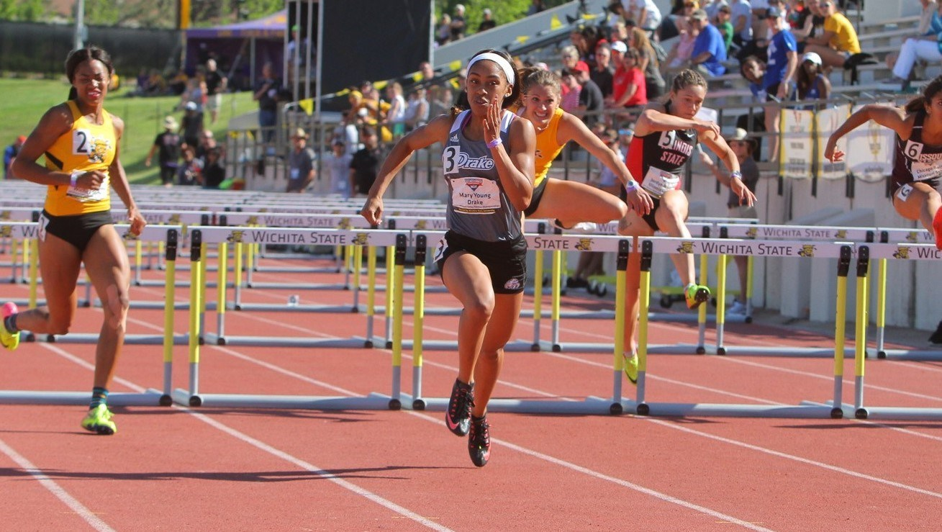
Talent Identification
Height is a major factor in short hurdles: Women 100 hurdlers tend to be shorter and more ballistic. Men 110 hurdlers tend to be taller in hip height and ballistic.
Most short hurdlers can produce fast 60m-200m times and can also have success in the Horizontal/Vertical events

Slide 7
Rhythm & Speed
Short hurdlers need to develop a keen sense of rhythmic timing and speed during workouts
Drills should be fast and ballistic.
Have to be able to sprint fast to hurdle fast
Wickets should be used to promote “Shuffle” and Turnover frequency: Discounting Hurdles
Use buzzers or whistles at given increments: 1st-3rd-5th-7th(all key transition hurdles)

Slide 8
Rhythm & Speed (cont…)
IMPORTANT!!!!
Rhythm is established by proper execution mechanics, which ‘can’ lead to faster times. So, practice times and type of workouts should correlate to the desired time. (‘What, How, and Why.’)
Speed allows better rhythm but BE CAREFUL: Speed can expose, create, or hide bad mechanics and technique. Both of which become more important as goals and competition levels increase.

Slide 9
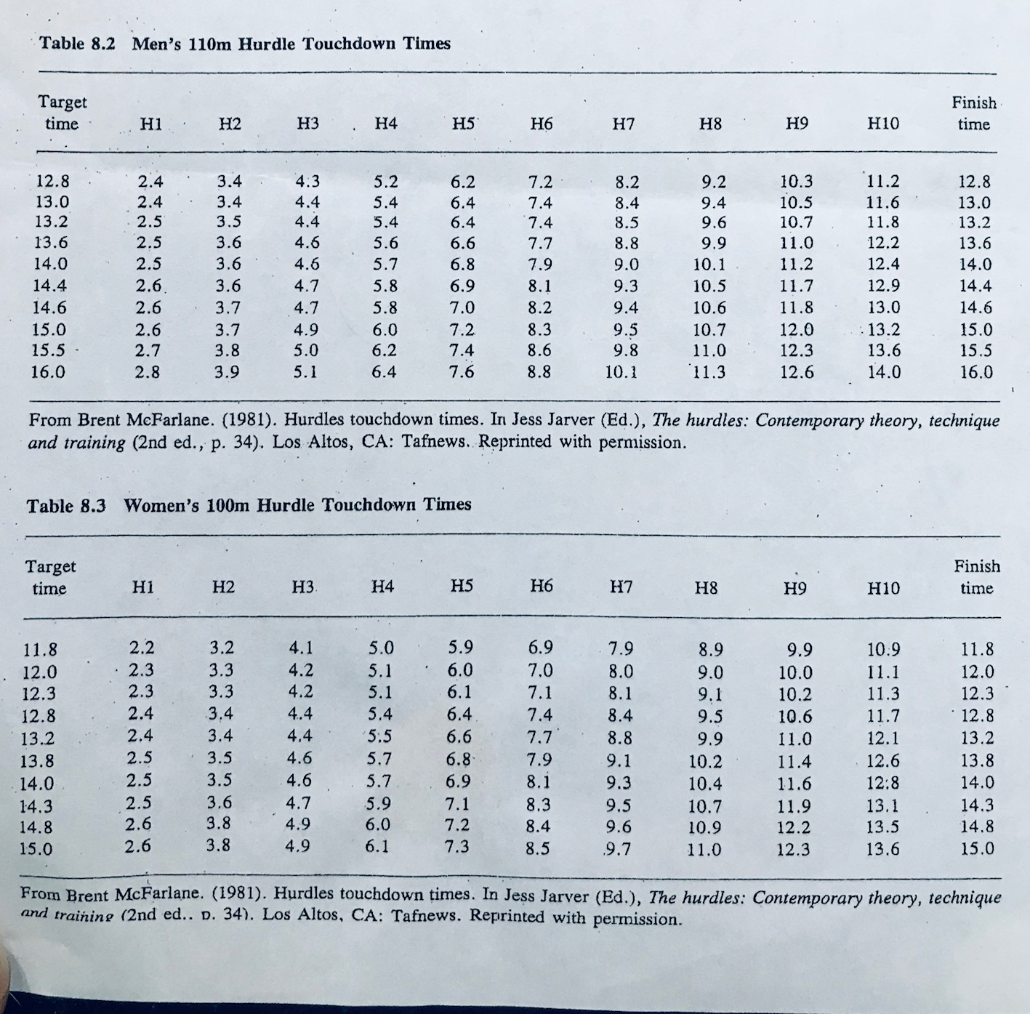
100/110H Pace Chart

Slide 10
100/110H Race Strategy
Push, out blocks to get up to top speed by 6 meters(4-5 steps)
Step, at take off plant foot should be under/slightly behind C.O.G. Hips tall and above crossbar of hurdle.

Slide 11
100/110H race strategy(cont…)
Position Lead leg hand out or high (depending on desired hurdle clearance & height of hurdler)
Drive” Drive ‘lead knee’ into top of hurdle. Cycle ‘trail-leg’ knee High and Tight into arm pit. ‘Finish’ trail leg: 90 degrees.

Slide 12
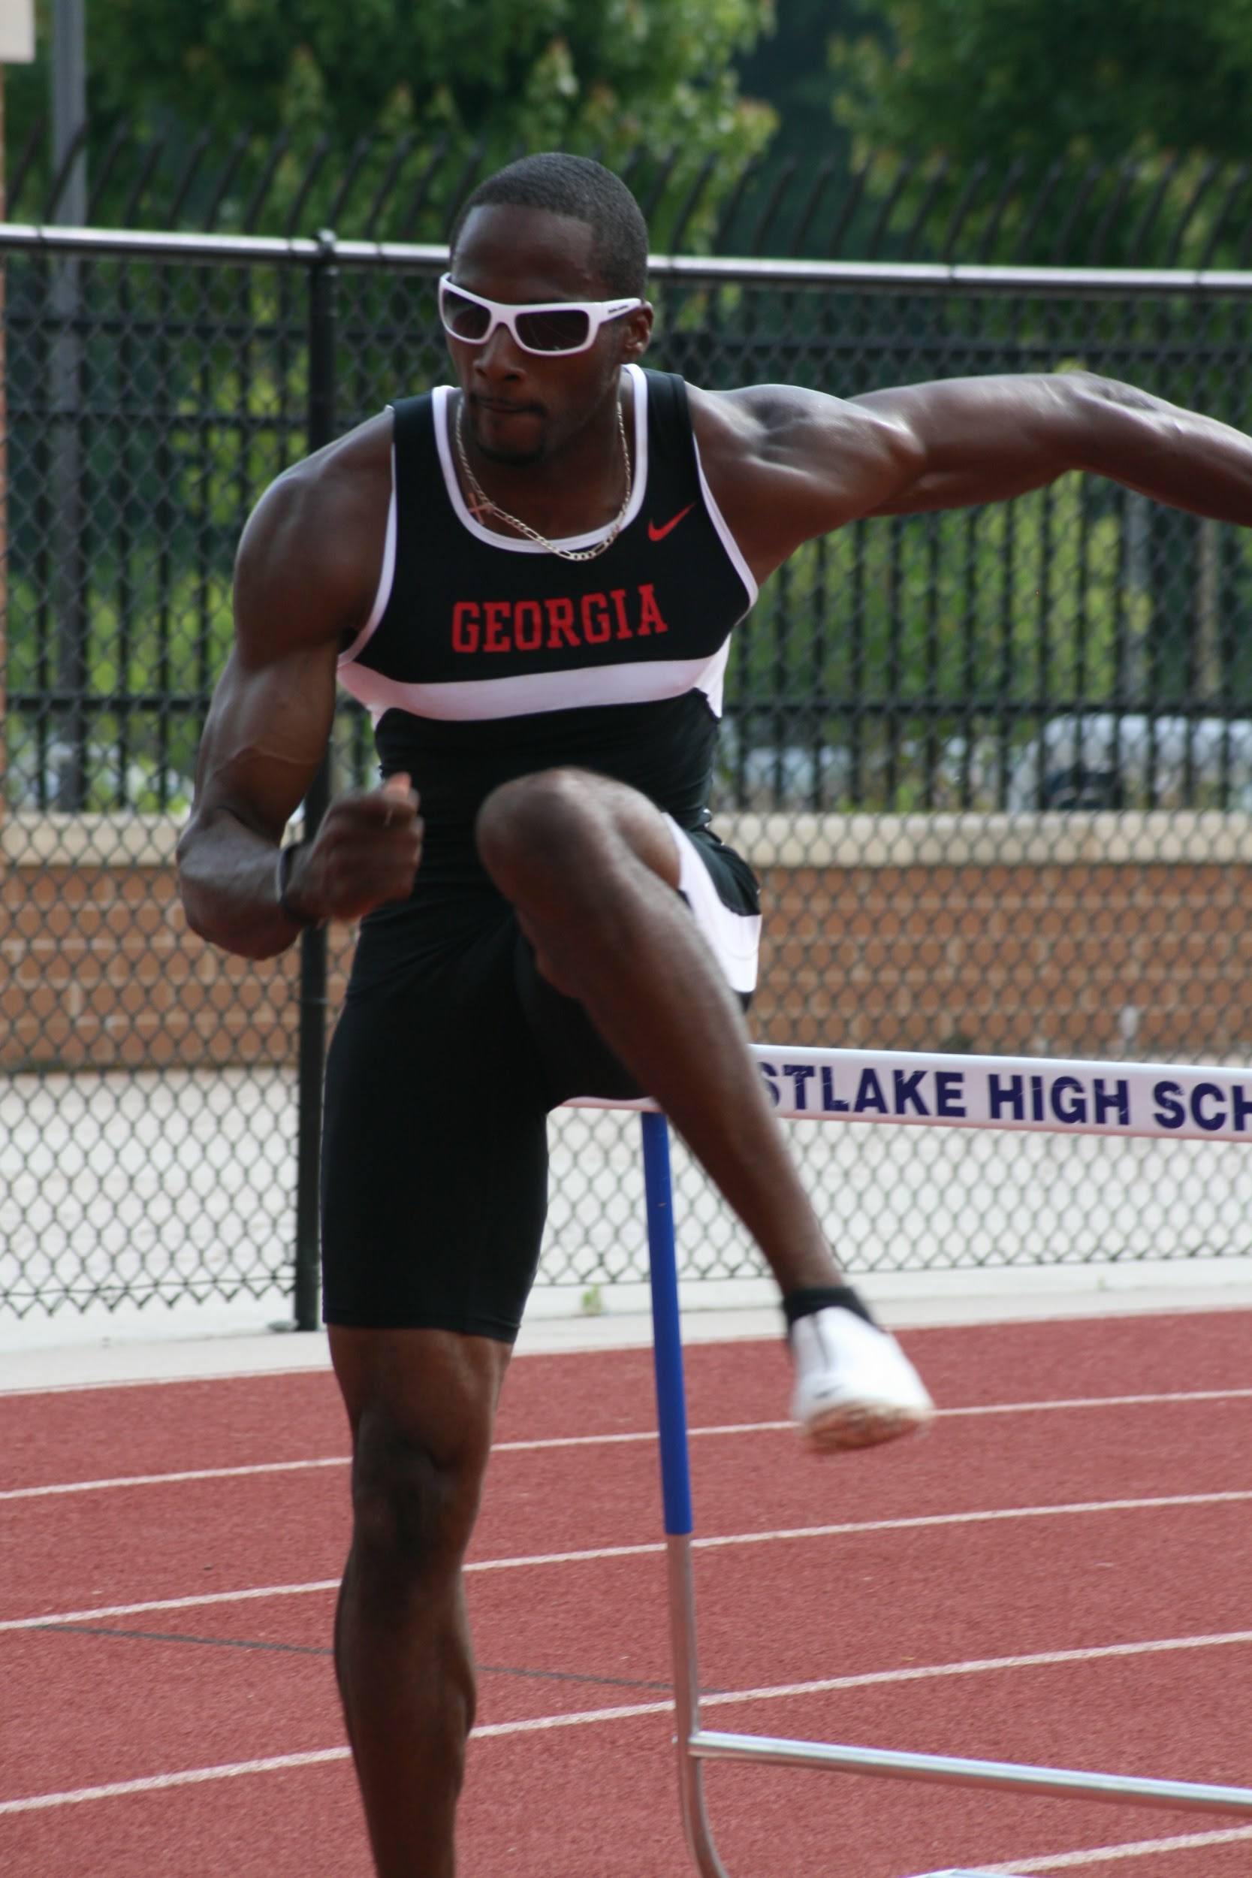
100/110H Race Strategy
Hurdles 1: Use to establish acceleration of speed and positioning into the hurdle
Hurdles 3: Speed should begin to be established; mechanics and rhythm should begin to clean up(stay tight!)

Slide 13
100/110H Race
Strategy(cont…)
Hurdle 5: Transition; Most important part of race; Should be a top speed with focus on keeping aggressive rhythm
Hurdle 7: Maintain FORM and FOCUS. Hurdles can come up FASTER and FATIGUE can set in
The Finish: Finish the race; you can win it or lose it here. Always sprint off the last hurdle and run through the line. Lean with CHEST.

Slide 14
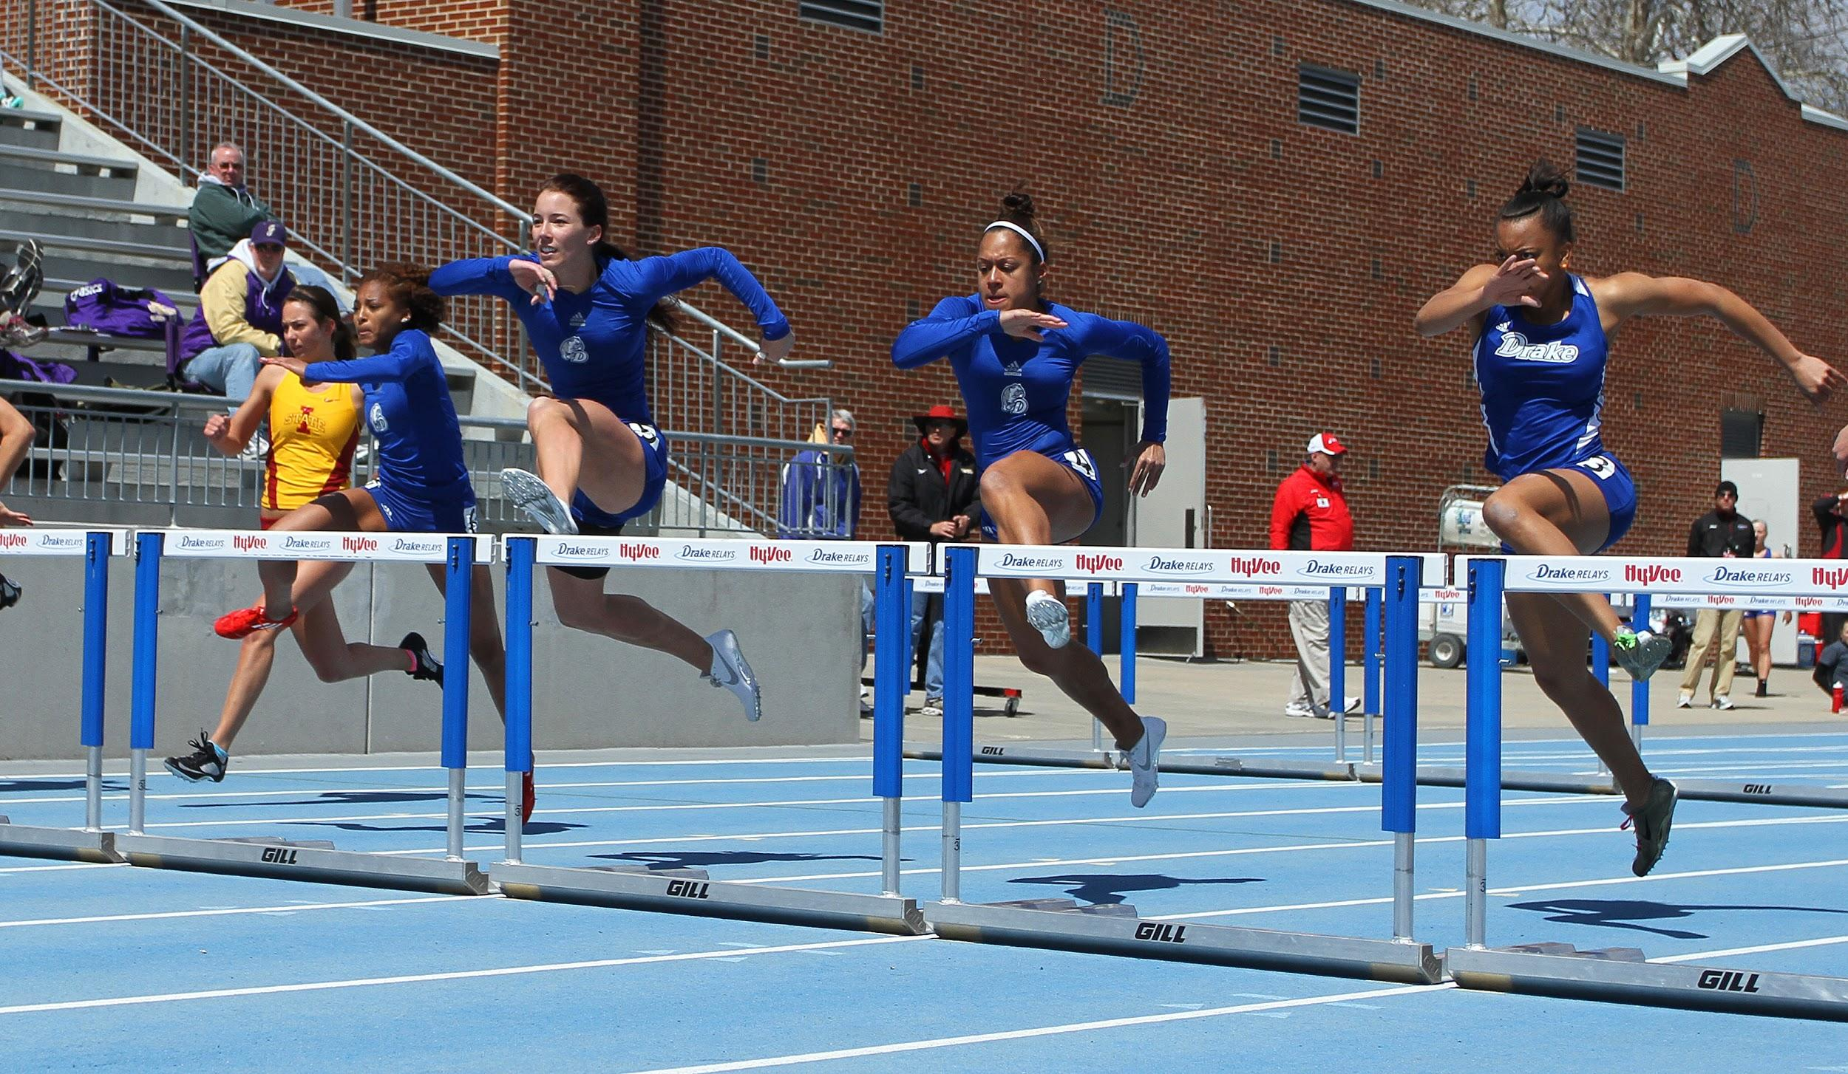
Intensity
High intensity and max velocity are two of the most important aspects to the success of 100/110h training
Both help to:
Simulate race conditions
Mastery of adaptation of speed to hurdling. (TIMING)
Gives confidence to athlete

Slide 15
Intensity (cont…)
Athletes can run near max intensity for a short time before injury, extreme fatigue, or cramping occurs
More reps in high intensity workouts should yield longer recovery times between reps
By nature this event requires more reps. DO not rush; attention to detail.
Always Err on the side of caution…New things aren’t always the best thing. Understand your athlete and what they are capable of.

Slide 16
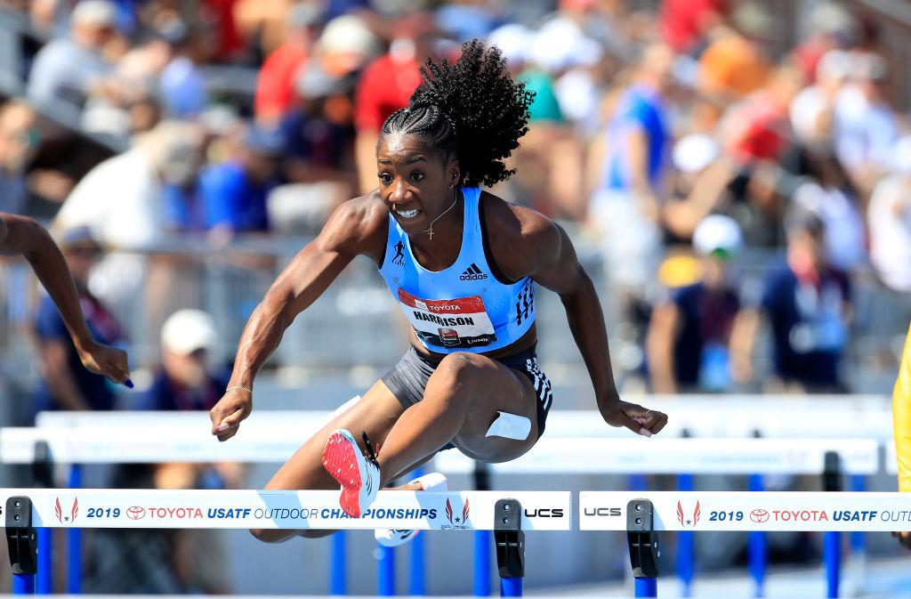
Percentage of Effort
The intensity of the athlete’s effort is expressed by percentage. (i.e..90%, 80%, etc.)
When hurdling the athlete will have to produce max effort. When doing flat(non-hurdle) work, you can run at various %

Slide 17
Recovery
A hard, easy, hard, easy daily training schedule is a good general way to maintain quality workouts and prevent injury.
Our collegiate schedule is more like: medium, hard, technical, hard, easy with weekends off
Highschool: View mid-week track meets as Hard Days and allow for proper recovery the following day.
Proper sleep, Nutrition, ice, foam rolling, and stretching(daily) are key components to effective recovery and better performances.

Slide 18
Recovery cont...
The 100 and 110H hurdles are mostly anaerobic events. In fact, the breakdown seems to be 95% anaerobic and *5% aerobic. The anaerobic ‘lactic’ system used during these two events is normally not great enough to dramatically affect the athlete. But if several rounds/ longer races are introduced, then the build up of lactic acid can affect the shorter race.
ie. Running a 400 race and 20 min. later running a 100/110h hurdle race.

Slide 19
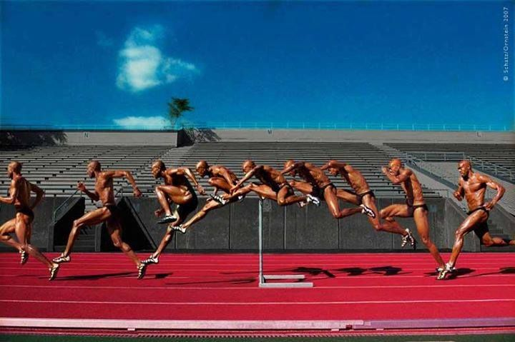
Periodization
General conditioning Period (Aug-Oct)- 8 weeks HS(Jan-Feb)4wk
Introduce Drills/Mechanics
Increase cardio-respiratory capacity
Increase tempo endurance
Develop blood circulation to main sprinting muscles
Building a base for multiple events and spring months

Slide 20
Periodization (cont…)
Pre-Competition Period (Oct-Dec) 8-10 weeks
HS(Feb-Mar)-4wks
Develop sprint and hurdle technique and specific strengths
Develop speed, power, and speed endurance.
Competition Period (Jan - May) 12-16 weeks
HS(Apr-May) 4wks
- Develop speed/hurdling and racing ability; Lower Volume
Volume
Intensity
Phases (time)

Slide 21
100m/110h Training Methods
Physical Requirement
Means of Development
General Endurance
Mid-distance runs, biking, swimming, continuous movement activities
Tempo Endurance
Segment runs
4x300m(w/100m walk)
5x250(w/100m walk)
6x 120m(w/100m jog back
Special Endurance
2x350m Full recovery
2x300m Full recovery
2x250m Full recovery

Slide 22
100/110h Training Methods
Physical Requirement
Means of Development
Speed Endurance
Runs from 20m to 150m
Ex. 3-4 x 150m
6 x 60m(walk back)
Strength Endurance
Long Hill Runs(100m+)
Sled Pulls
Speed
Block starts, Relay exchanges, runs under 60m
Power
Short Hills(10-30m), Short resistance runs, Plyometrics

Slide 23
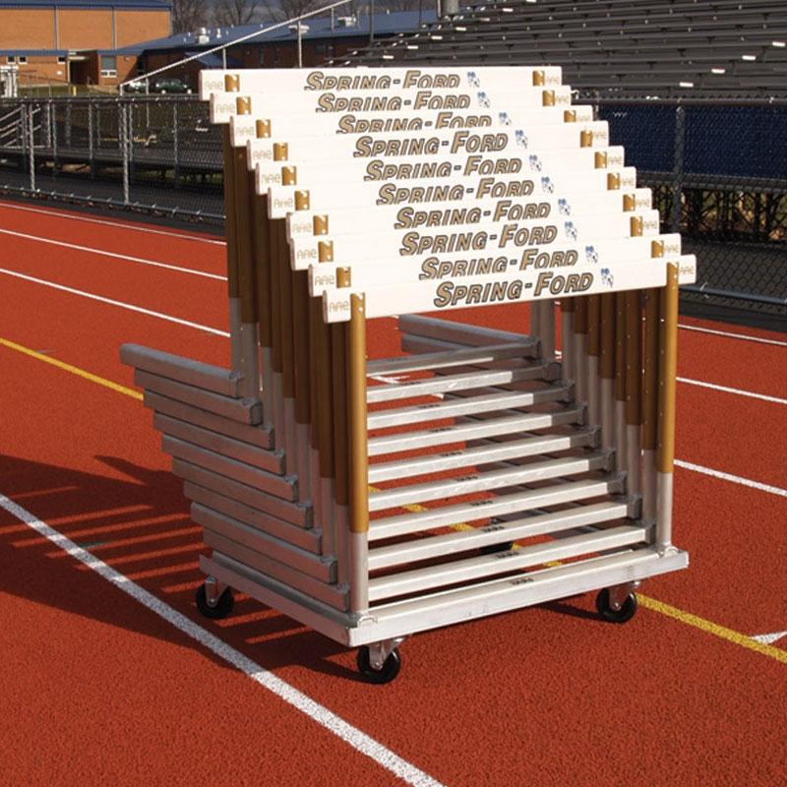
Hurdle Warm-Up
The purpose of the warm-up is to elevate the body’s core temperature, so that the muscles can use their full elasticity. This in turn will reduce and/or prevent injury, increase flexibility, and increase blood flow to the main muscles.

Slide 24
100/110h Warm-Up (cont…)
5 Components to the warm-up
Jogging
Static stretching
Dynamic stretching
Sprint Drills
Hurdle Drills

Slide 25
Team Warm-Up
400m jog
5m static stretching and rolling out
Dynamic stretching
Leg swings
Toe Taps, Quick steps
A-skips, Dynamic A-skips
B-skips, Dynamic B-skips

Slide 26
Team Warm-Up(cont…)
Toe touches, reverse toe touches
Fast-legs, skip-n-scoot
High Knee, A-Runs
W.G.S, skip-n-scoot
Side shuffles
Backwards running
Accelerations(20,30, 50)
2 x

Slide 27
General Conditioning Sample
Week 1 and Week 3
Monday
Tuesday
Wednesday
Thursday
Friday
15min run
Hurdle Drills
3m run x 2
2m run x 2
1m run x 2
(3m rest)
15min run
Hurdle Drills
12 x 120m w/jog back recovery
Hurdle Mobility, 10 x 100 at 1min intervals
Hurdle Drills
Monday
Tuesday
Wednesday
Thursday
Friday
5x 150m hill runs w/jog back recovery
Hurdle Drills
20min run
5 x 250m w/ 50m walk recovery
Hurdle Drills
10min run
Hurdle Mobility, 5 x 100 at 1min intervals
Hurdle Drills

Slide 28
Early Season Sample
Week 1 and Week 3
Monday
Tuesday
Wednesday
Thursday
Friday
Block work, Technical Hurdle work, Ab work, cool down
3x300/150 w/ 1min rest between 300/150
6 x 100m @ 15s. 1min intervals
4 x
13 hurdles (30-39in). Full recovery
4x 60m Sled pulls
Monday
Tuesday
Wednesday
Thursday
Friday
Hurdle Drills
Starts @ 1h, 3h, 5h
3 x 300 w/Full Recovery
6 laps ins/outs, Ab work, roll out
Hurdle Drills
4 x 200m @ 23-24s
4x1
exchanges, 3 x 60m sled pulls

Slide 29
Championship Week
Monday
Tuesday
Wednesday
Thursday
Friday-Saturday
3 x 1h(90%)
2x 3h
1x 5h
1x 7h
1 1 x 10h
Warm-up only
Block Starts
Compete
All workouts preceded with a full warm-up

Slide 30
Checkpoints
Mid and late February
2 x 300 with full recovery
Early March
200’s, 150’s
Late April
100/60 time trial

Slide 31
100/110H
Justin Gaymon (UGA) Kelton Kemp (Belhaven)
‘07’- 13.85 ‘19’- 15.32
LaRon Bennett (UGA) Mary Young(Drake)
‘05’- 13.86 ‘17’- 13.1
Estaban Guzman(UGA) Marissa Smith (Drake)
‘04’ - 13.90 ‘13’- 13.64
Travis Marsh (Drake) Sarah Yeager(Drake)
‘14’- 14.77 ‘13’- 13.44

Slide 32
Introduction to the 400/400 Hurdles
One of the most demanding events in track and field
Success in this event requires a great deal of determination, pain tolerance, and heart.
‘Quarter’ runners/hurdlers are heralded for their tenacity and courage; this in turn makes them team leaders
Truly an event where “hard work will pay off.”

Slide 33
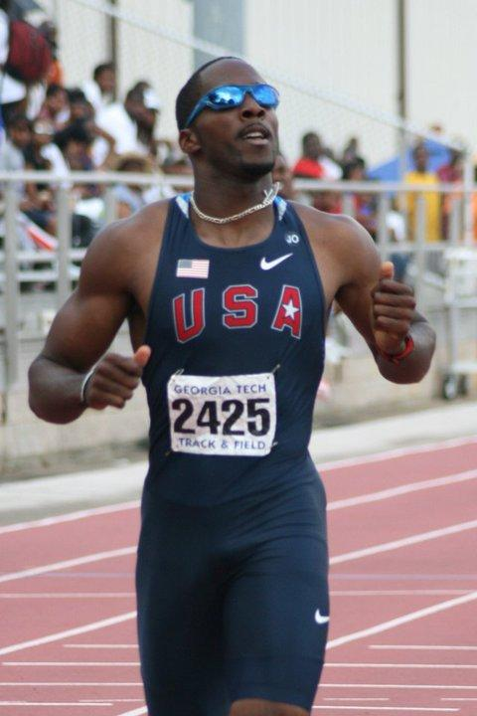
Talent Identification
There are no size requirements, but tall and thin predicts better than short and stocky
During a 300m time trial, watch the athletes after crossing the line. The short sprinters stop shortly after they finish. The 400m runners run through the line for another 20-30m.(it’s not scientific, just experience)

Slide 34
Pace
Quarter Hurdlers need to develop a keen sense of pace during workouts
Call splits at each interval
Use buzzers or whistles at given increments
Show athlete each 100m split/split between hurdles at the end of each run
This prevents going out too slow or two fast in a race

Slide 35
Pace (cont…)
IMPORTANT!!!!
Pacing is establish by proper execution, which ‘can’ lead to faster times. So, practice times and type workouts should correlate to the desired time. (‘Why, What, and How.’)
Ex: An athlete running who wants to run 50s in the 400h should average: 12.3s/100m, 24.6s/200, 37.0/300,( the more consistently they can hit these marks, the easier to hit 50s.

Slide 36
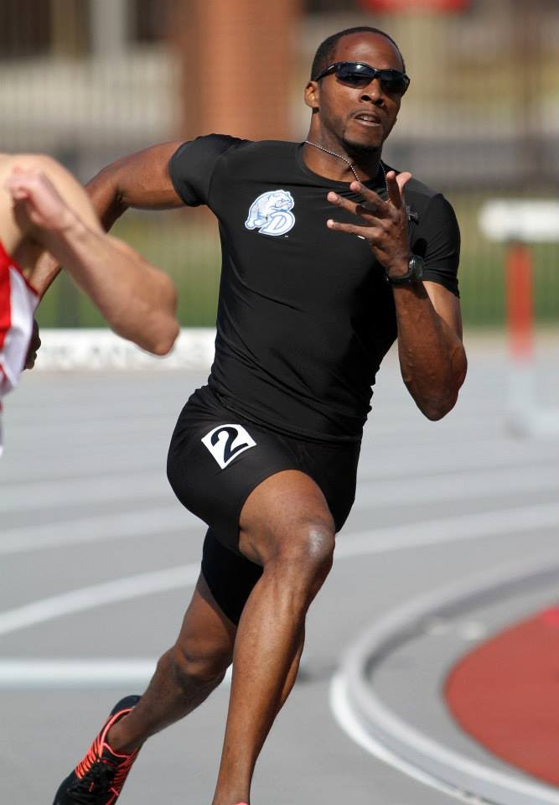
300/400H Race Strategy
“P” is for Push, to push out blocks to get up to top speed by 50m
“P” is for Pace, from 50 to 200m to get into good rhythm going to get on pace for how fast your looking to go.

Slide 37
300/400h race strategy(cont…)
“P” is for Positioning for when you get to top of curve and see where you are to make a move… (Now you can race)
“P” is for Poise for last 110 where you maintain your form and Heart to get you home.

Slide 38
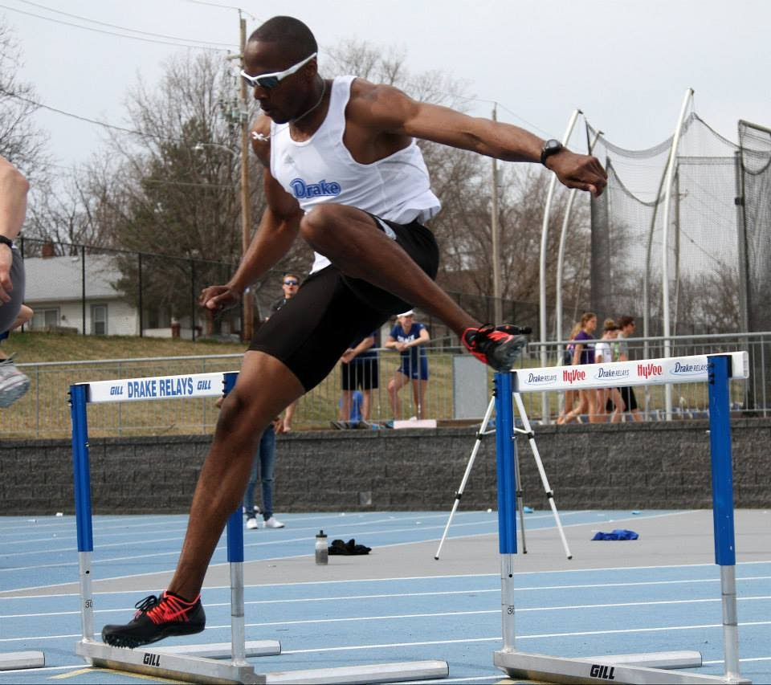
300/400h Phases
Hurdles 1-2: Use power and speed to establish steps and rhythm
Hurdles 3-5: focus and maintain rhythm; DON’T COMPETE

Slide 39
300/400h Phases (cont…)
Hurdle 6-8: Transition; Most important part of race; Do I stay or do I go? Hands up and maintain full range of motion.
Hurdle 9-10: Heart; The most painful part of the race; maintain form as best as possible
The Finish: Finish the race; you can win it or lose it here.

Slide 40
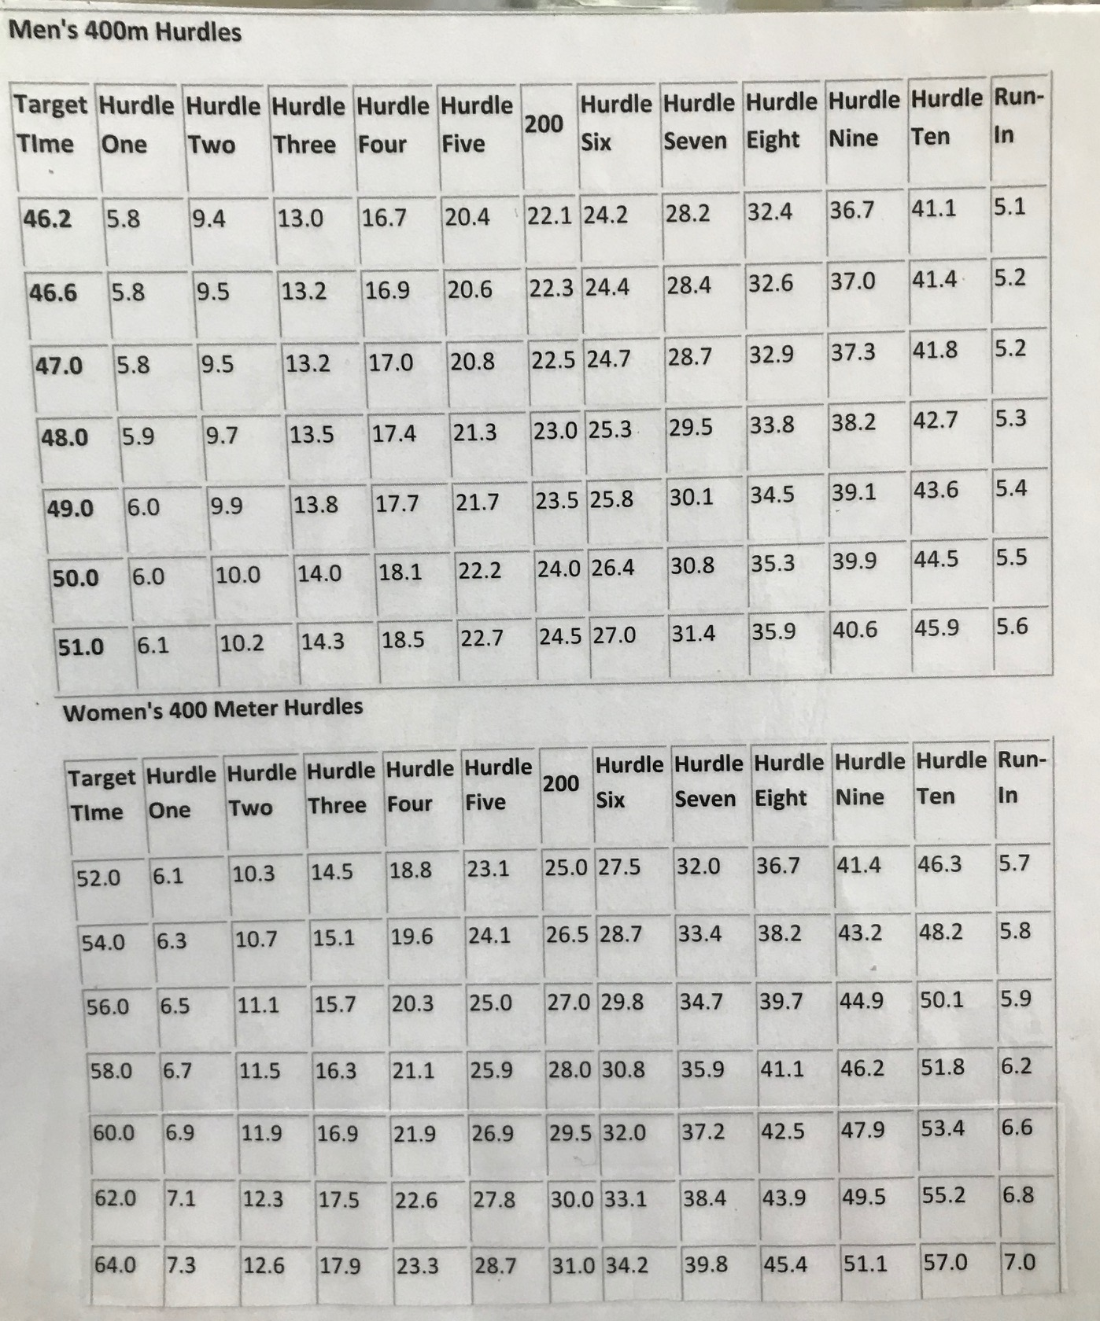
300/400h Pace Chart

Slide 41
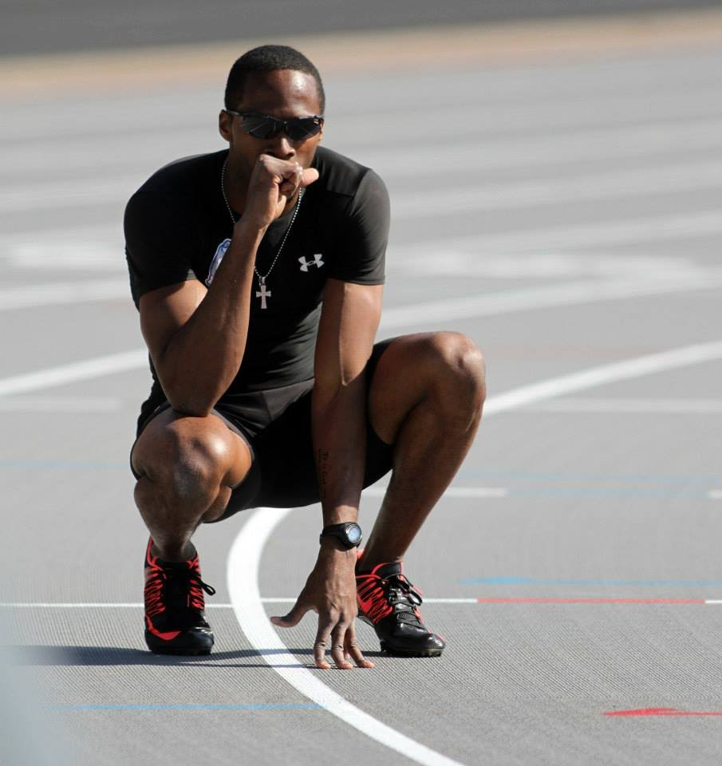
Intensity
High intensity is one of the most important aspects to the success of 300/400h training
High intensity helps to
Simulate race conditions
Simulate race recovery time
Give confidence to athlete
(Quantity must go down with near max efforts)

Slide 42
Intensity (cont…)
Athletes can run near max intensity for a short time before injury, extreme fatigue, or cramping occurs
The coach should never feel bad about cutting workouts because of fatigue
The coach also never feel bad about cutting workouts because of a great performance
Always Err on the side of caution…

Slide 43
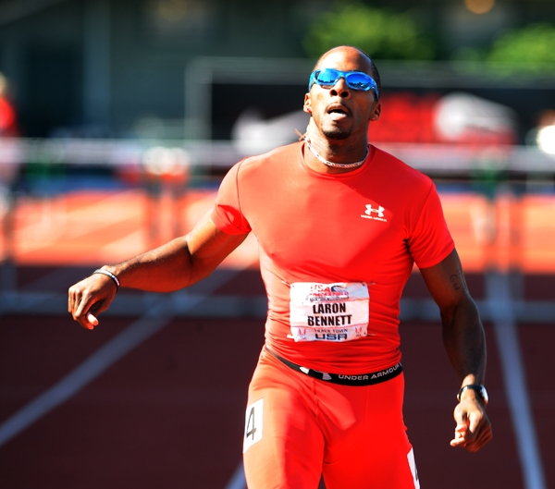
Percentage of Effort
The intensity of the athlete’s effort is expressed by percentage. (i.e..90%, 80%, etc.)
It’s very unlikely you will get 90% effort on every workout, based on the athletes personal best, so you must base the percentage on pace and how they are feeling.

Slide 44
Recovery
A hard, easy, hard, easy daily training schedule is a good general way to maintain quality workouts and prevent injury.
Our collegiate schedule is more like: medium, hard, technical, hard, easy with weekends off
Proper sleep, Nutrition, ice, foam rolling, and stretching(daily) are key components to effective recovery and better performances.

Slide 45
Recovery cont...
The 300 and 400 hurdles are mostly anaerobic events. In fact, the breakdown seems to *90% anaerobic and *10% aerobic. The anaerobic ‘lactic’ system used during these two events usually produces a great deal of lactic acid with 35-40 seconds(and can continue on for around 60seconds); this causes a great deal of fatigue. So we base our training around conditioning our bodies to last towards the upper end of 35 to 40 seconds.

Slide 46
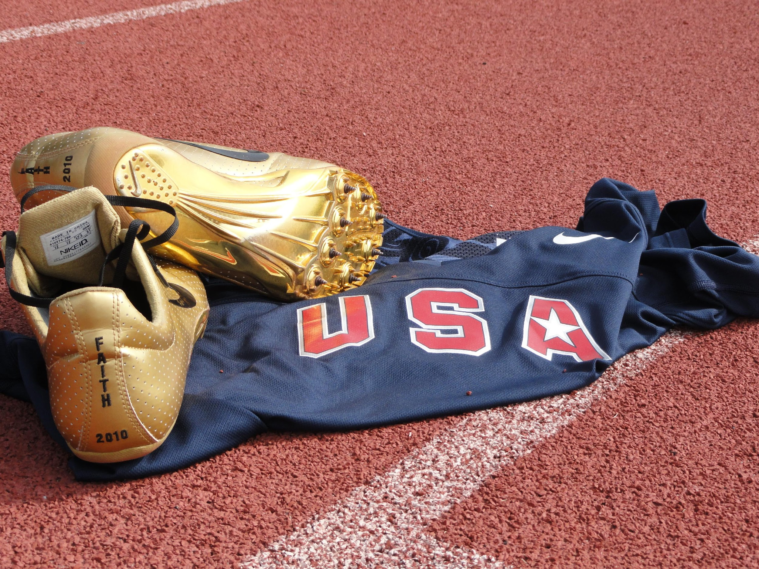
Periodization
General conditioning Period (Aug-Oct)- 8 weeks
Increase cardio-respiratory capacity
Increase tempo endurance
Develop blood circulation to main sprinting muscles

Slide 47
Periodization (cont…)
Pre-Competition Period (Oct-Dec) 8-10 weeks
Develop sprint and hurdle technique and specific strengths
Develop speed, power, and speed endurance.
Competition Period (Jan - May) 12-16 weeks
- Develop speed/hurdling and racing ability
Volume
Intensity
Phases (time)

Slide 48
300m/400h Training Methods
Physical Requirement
Means of Development
General Endurance
Distance runs, biking, swimming, continuous movement activities
Tempo Endurance
Segment runs
8x300m(w/100m walk)
10x250(w/100m walk)
12x 120m(w/100m jog back
Special Endurance
2x500m Full recovery
2x350m Full recovery
2x300m Full recovery

Slide 49
300m/400h Training Methods
Physical Requirement
Means of Development
Speed Endurance
Runs from 20m to 150m
Ex. 3-4 x 150m
6 x 60m(walk back)
Strength Endurance
Long Hill Runs(100m+)
Sled Pulls
Speed
Block starts, Relay exchanges, runs under 60m
Power
Short Hills(10-30m), Short resistance runs, Plyometrics

Slide 50
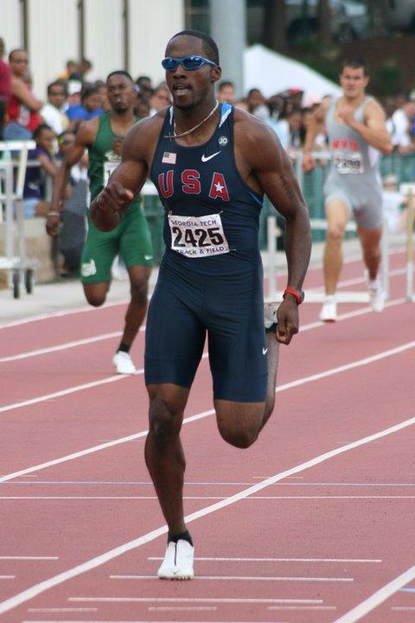
Team Warm-Up
The purpose of the warm-up is to elevate the body’s core temperature, so that the muscles can use their full elasticity. This in turn will reduce and/or prevent injury, increase flexibility, and increase blood flow to the main muscles.

Slide 51
Team Warm-Up (cont…)
5 Components to the warm-up
Jogging
Static stretching
Dynamic stretching
(Hurdle Drills)
Sprint Drills
Sprinting

Slide 52
Belhaven Warm-Up
400m jog
5m static stretching and rolling out
Dynamic stretching
Leg swings
Toe Taps, Quick steps
A-skips, Dynamic A-skips
B-skips, Dynamic B-skips

Slide 53
Belhaven Warm-Up(cont…)
Toe touches, reverse toe touches
Fast-legs, skip-n-scoot
High Knee, A-Runs
W.G.S, skip-n-scoot
Side shuffles
Backwards running
Accelerations(20,30, 50)
2 x 150m @80%

Slide 54
General Conditioning Sample
Week 1 and Week 3
Monday
Tuesday
Wednesday
Thursday
Friday
15min run
3m run x 2
2m run x 2
1m run x 2
(3m rest)
15min run
12 x 120m w/jog back recovery
Hurdle Mobility, 10 x 100 at 1min intervals
Monday
Tuesday
Wednesday
Thursday
Friday
10x 150m hill runs w/jog back recovery
20min run
10x 250m w/ 50m walk recovery
20min run
Hurdle Mobility, 10 x 100 at 1min intervals

Slide 55
Early Season Sample
Week 1 and Week 3
Monday
Tuesday
Wednesday
Thursday
Friday
Block work, Technical work, Ab work, cool down
3x600/300 w/ 1min rest between 600/300
12 x 100m @ 14s. 1min intervals
2 x 300-100-100 (33-35s). Full recovery
6 x 60m Sled pulls
Monday
Tuesday
Wednesday
Thursday
Friday
3x 40m, 3 x60m
3 x 500m w/5min recovery
6 laps ins/outs, Ab work, roll out
4 x 200m @ 23-24s
4x4 exchanges, 3 x 60m sled pulls

Slide 56
Championship Week
Monday
Tuesday
Wednesday
Thursday
Friday-Saturday
3 x 150m(90%)
300-100-100, (33sec)
Warm-up only
Block starts x 4
Compete
All workouts preceded with a full warm-up

Slide 57
Checkpoints
Mid and late October
2 x 500 with full recover
Early November
350’s, 200’s
Late November
300 time trial

Slide 58
2 x 500m
Torrin Lawrence LaRon Bennett
‘08- 67.7, 67.3 ‘03- 63.5, 61.9
‘10- 62.0, 63.0 ‘06- 62.5, 63.9
‘09- 63.7, 63.9
David Dickens
‘05- 64.0, 63.4 Travis Marsh
‘06- 62.4, 63.8 ‘12- 65.4, 67.0
Justin Gaymon Kia Asberry
‘08- 64.0, 64.9 ‘13- 66.1, 66.3
‘09- 63.7, 63.9

Slide 59
500m
LaRon Bennett 59.99
Torrin Lawrence 61.0
David Dickens 61.7
Justin Gaymon 62.2
Travis Marsh 64.4
Kia Asberry 64.7

Slide 60
500m
LaRon Bennett 59.99 Georgia
Torrin Lawrence 61.0 Georgia
David Dickens 61.7 Georgia
Justin Gaymon 62.2 Georgia
Travis Marsh 64.4 Drake
Kia Asberry 64.7 Drake

Slide 61
300m Time Trial
Athlete
300m Time
Personal Best
T. Lawrence
31.8 (official ncaa record 32.32
54.03i, 20.55, (43.9spl)
D. Dickens
32.3
10.46, 20.6, 45.91, (44.8)
L. Bennett
32.7
13.86, 48.74,(44.6)
J. Gaymon
33.0
13.85, 48.46, 45.94i
K. Asberry
33.9
6.95i, 48.2i, 51.7
T. Marsh
34.7
47.8i, 14.4, 52.0

Slide 62
300m Time Trial
Athlete
300m Time
Personal Best
T. Lawrence
31.8 (official ncaa record 32.32
54.03i, 20.55, (43.9spl)
D. Dickens
32.3
10.46, 20.6, 45.91, (44.8)
L. Bennett
32.7
13.86, 48.74,(44.6)
J. Gaymon
33.0
13.85, 48.46, 45.94i
K. Asberry
33.9
6.95i, 48.2i, 51.7
T. Marsh
34.7
47.8i, 14.4, 52.0

Slide 63
Thank You

